Slide 1
What food is it?
2nd semester, grade5, lesson1

Slide 2
The ____ tastes good.

Slide 3
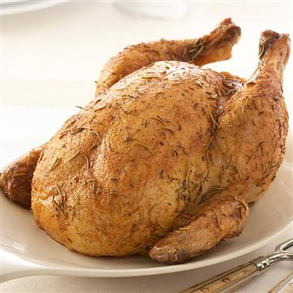
The chicken tastes good.

Slide 4
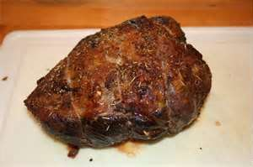
The ____ tastes good.

Slide 5
The beef tastes good.

Slide 6
The ____ taste good.

Slide 7
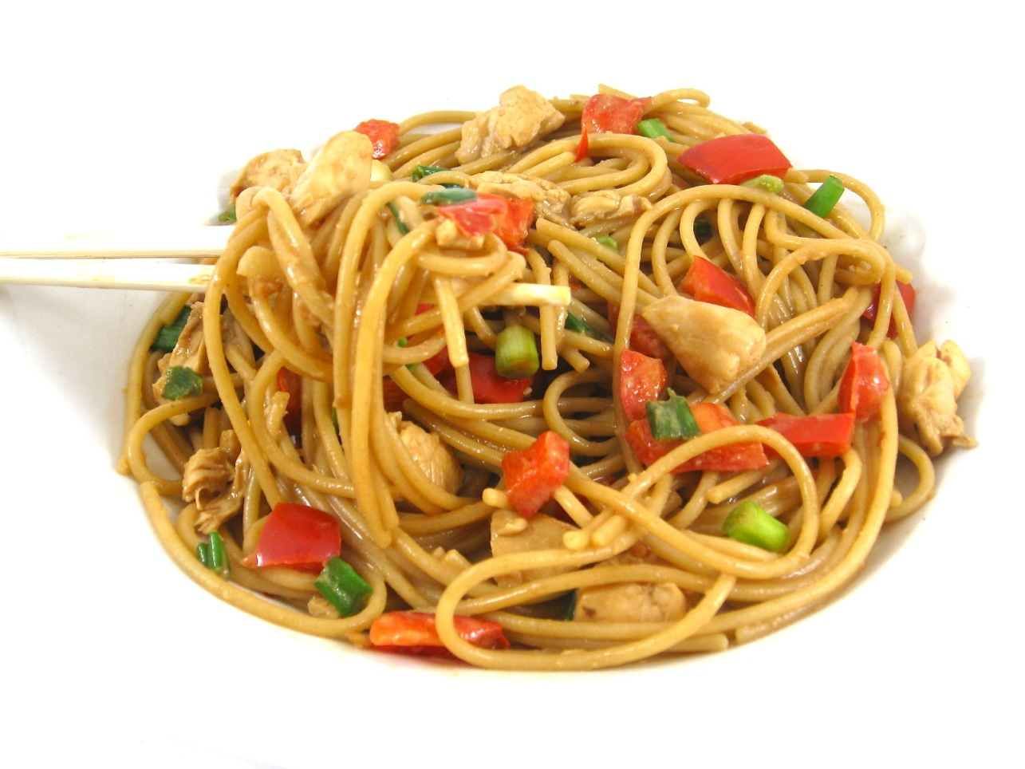
The noodles taste good.

Slide 8
The ____ smell fantastic.

Slide 9
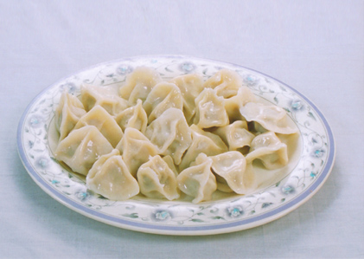
The dumplings smell fantastic.

Slide 10
The ____ smells delicious.

Slide 11
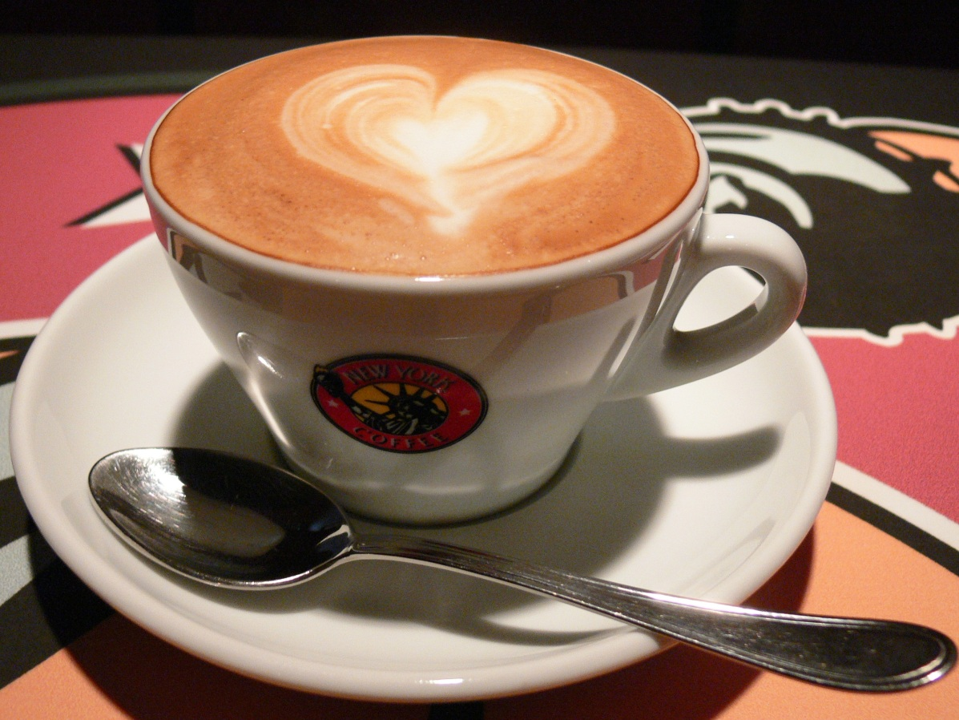
The coffee smells delicious.

Slide 12
The ____ looks good.

Slide 13
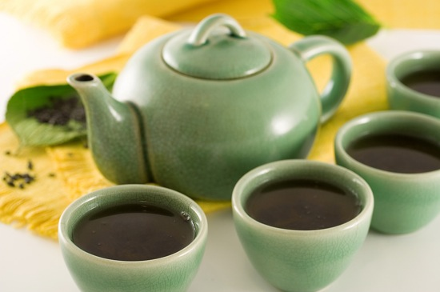
The tea looks good.

Slide 14
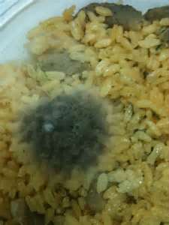
The ____ looks bad.

Slide 15
The rice looks bad.

Slide 16
More food is coming!

Slide 17
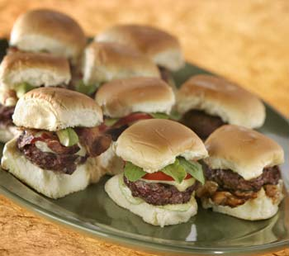
The ____ taste great.

Slide 18
The hamburgers taste great.

Slide 19
The ____ smells good.

Slide 20
The pasta smells good.

Slide 21
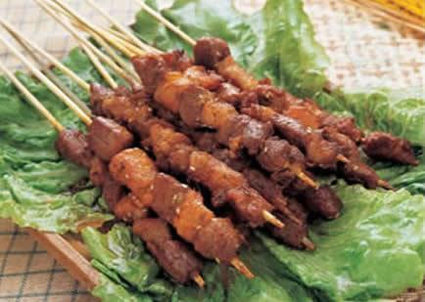
The ____ look good.

Slide 22
The kebabs look good.

Slide 23
The __ __ looks fantastic.

Slide 24
The chicken soup looks fantastic.

Slide 25
The __ __ looks delicious.

Slide 26
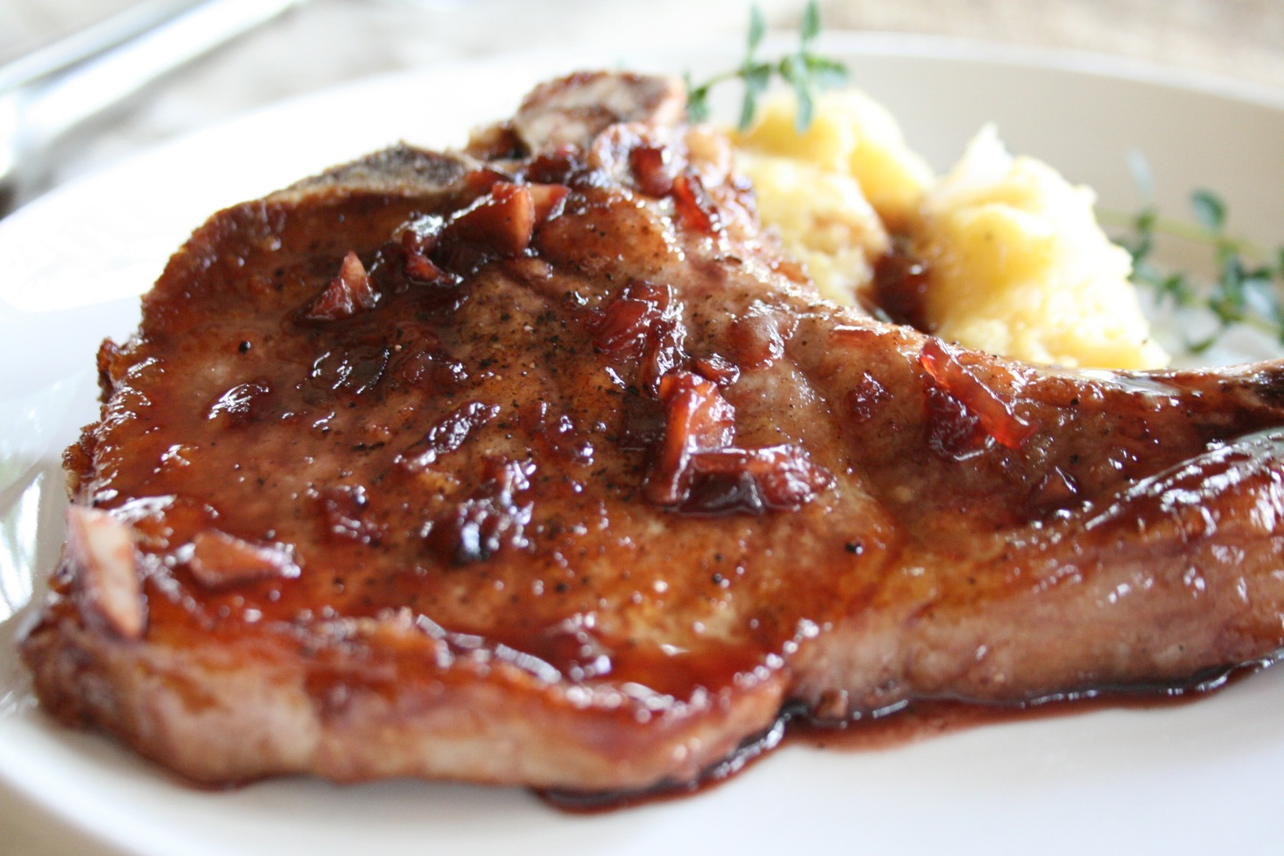
The pork chop looks delicious.

Slide 27
The __ __ smells horrible!

Slide 28
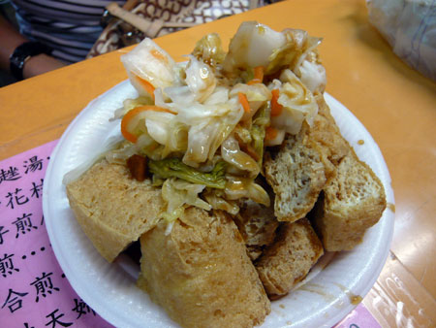
The stinky tofu smells horrible!

Slide 29
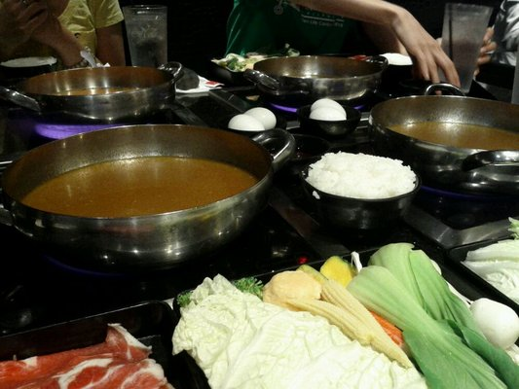
The __ __ smells delicious.

Slide 30
The hot pot smells delicious.

