Slide 1
Thinking on Paper
Reading Strategies
黃毓珍
宜蘭縣成功國小
2015年4月
Notes:
講義放上能力指標/information gap 學習單/討論問題筆記欄

Slide 2
Topics
Framework
Principles & Activities
Reading Tasks
Reading Assessment
Framework
Teaching Principles & Activities
Reading Tasks
Reading Assessment

Slide 3
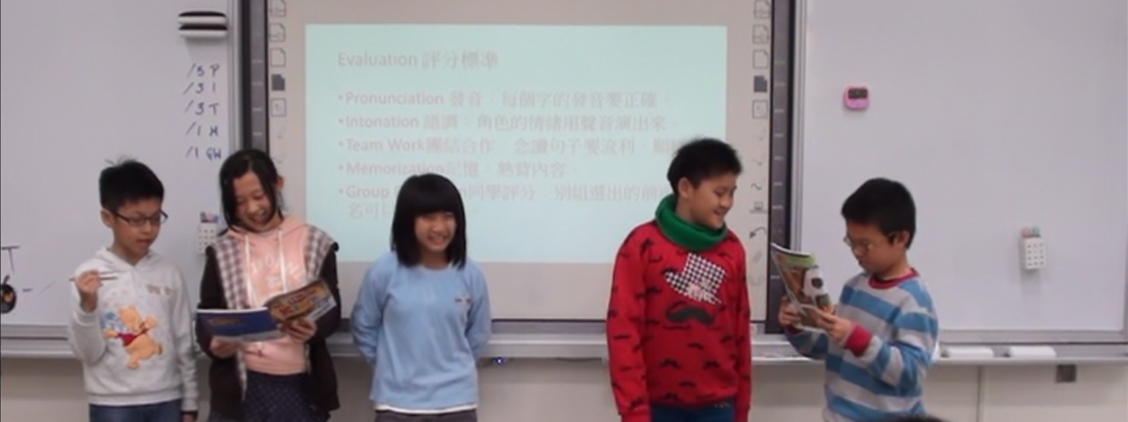
framework

Slide 4
Discussion 1
Framework
Principles & Activities
Reading Tasks
Reading Assessment
Can LSW been taught through reading?

Slide 5
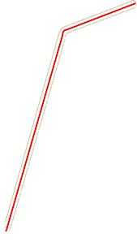
Curriculum Guidelines
Framework
Principles & Activities
Reading Tasks
Reading Assessment
Beginner
R
W
S
L
Notes:
於國小三、四年級的啟蒙階段強調聽、說的學習，讓兒童藉由豐富的英語聽、說的學習，奠定良好的英語口語溝通基礎。然而即使是在啟蒙階段，讀、寫活動並未偏廢，而是適時融入課程，讓學生藉由接觸簡易的閱讀材料，以及適當的臨摹及填寫字詞等練習，自然體驗語言的不同形式，以收聽、說、讀、寫四者相輔相成的效果。

Slide 6
Discussion 2
Framework
Principles & Activities
Reading Tasks
Reading Assessment
 | Goals | Curriculum Guidelines
3rd - 4th grade
5th - 6th grade
Notes:
白板/寫在黑板上

Slide 7
Framework
Principles & Activities
Reading Tasks
Reading Assessment
Learn to read
Read to learn

Slide 8
Teaching Framework
Framework
Principles & Activities
Reading Tasks
Reading Assessment

Slide 9
Main Goals for 5th-6th graders
Framework
Principles & Activities
Reading Tasks
Reading Assessment

Slide 10
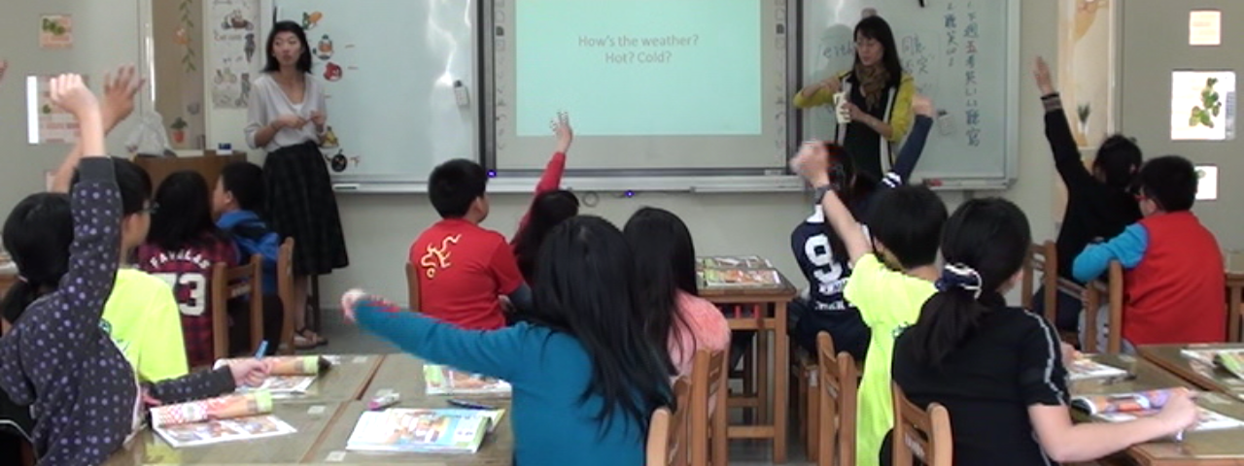
Reading Principles and Activities
Notes:
http://design.dsjh.tyc.edu.tw/94/94eng_com/1.htm

Slide 11
Principles
Framework
Principles & Activities
Reading Tasks
Reading Assessment
Principles
ZPD
Scaffolding
Bottom-up/Top Down/ Interactive
Cooperation
Reading Stages
Strategies
Questions

Slide 12
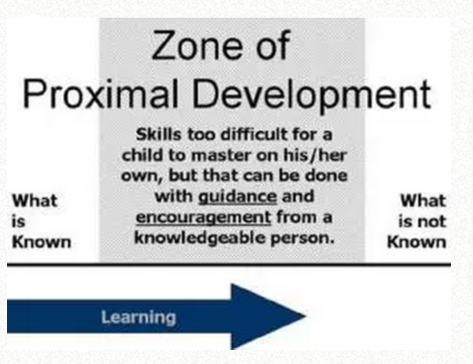
ZPD
Framework
Principles & Activities
Reading Tasks
Reading Assessment
Principles
Reading Stages
Strategies
Questions
http://www.simplypsychology.org/Zone-of-Proximal-Development.html

Slide 13
Scaffolding
Framework
Principles & Activities
Reading Tasks
Reading Assessment
Principles
Wood et al. (1976) Effective Scaffolding:
Gaining and maintaining the learner’s interest in the task.
Making the task simple.
Emphasizing certain aspects that will help with the solution.
Control the child’s level of frustration.
Demonstrate the task.
Reading Stages
Strategies
Questions

Slide 14

Bottom-up/Top Down/ Interactive
Framework
Principles & Activities
Reading Tasks
Reading Assessment
Principles
Reading Stages
Strategies
Questions
http://www.readinghorizons.com/research/practical-bottom-up-strategies-for-teaching-reading

Slide 15

Bottom-up/Top Down/ Interactive
Framework
Principles & Activities
Reading Tasks
Reading Assessment
Principles
Reading Stages
Strategies
Questions
http://www.readinghorizons.com/research/practical-bottom-up-strategies-for-teaching-reading

Slide 16
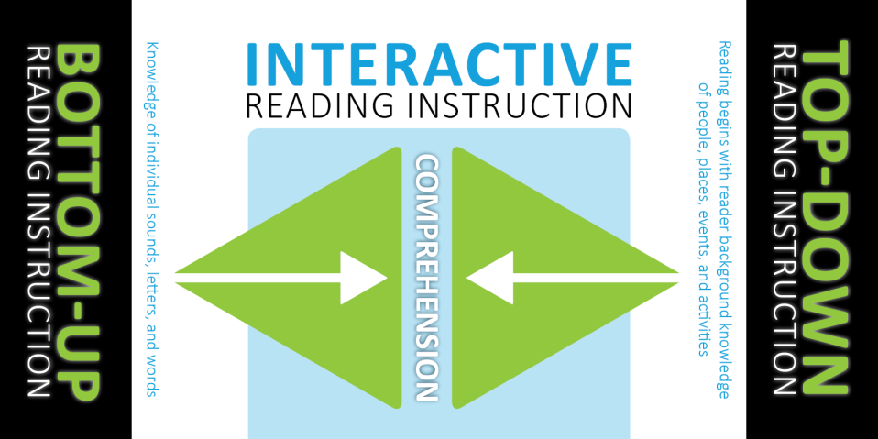
Bottom-up/Top Down/ Interactive
Framework
Principles & Activities
Reading Tasks
Reading Assessment
Principles
Reading Stages
Strategies
Questions
http://www.readinghorizons.com/research/practical-bottom-up-strategies-for-teaching-reading
Notes:
http://www.readinghorizons.com/research/practical-bottom-up-strategies-for-teaching-reading

Slide 17
Cooperation
Framework
Principles & Activities
Reading Tasks
Reading Assessment
Principles
Pair work & Group work
Reading Stages
Preparing your class
Designing Activities
Strategies
Differentiation
Competition? Cooperation?
Questions
Rules
Seating
Notes:
Pretask—全班、個人、練習、示範小組合作。Task-老師facilitator / coach/勿直接講答案/引導
Post task—再強調重要概念/讓學生反思

Slide 18
Discussion 3
Framework
Principles & Activities
Reading Tasks
Reading Assessment
Principles
Initial Stage V.S Later Stage (p.17-20)
Other resources
Reading Stages
Strategies
Questions
Notes:
對照能力指標和之前的分類/stage定義 低中年級→高年級

Slide 19
Teach Reading Strategies
Framework
Principles & Activities
Reading Tasks
Reading Assessment
Principles
閱讀中
Reading Stages
Strategies
閱讀前
Read to Learn?
Questions
Notes:
指標的不足3-1-8during reading 3-1-9 pre-reading

Slide 20
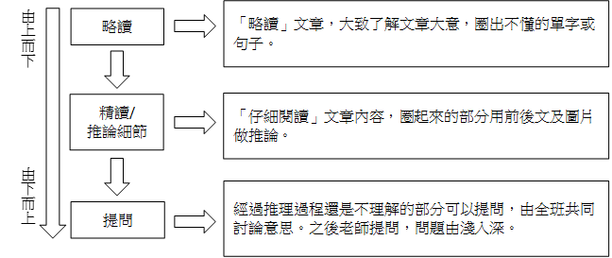
Teach Reading Strategies
Framework
Principles & Activities
Reading Tasks
Reading Assessment
Principles
閱讀中步驟 活動說明
Top Down
Reading Stages
Bottom up
Strategies
Interactive
Questions

Slide 21

Let’s try some ideas
Framework
Principles & Activities
Reading Tasks
Reading Assessment
Principles
1.KWL Reading Strategy
2.Automatic reaction/ Knee_jerk
3.Story Mapping
4.Story Bingo
Reading Stages
Strategies
Questions
Source: 簡靜雯:英文段落篇章教學
Notes:
放E-books

Slide 22
1.KWL Reading Strategy
Framework
Principles & Activities
Reading Tasks
Reading Assessment
Principles
K What you have Known | W What you want to know | L What you have learned
Reading Stages
Strategies
Questions
Notes:
KWL can also be used by teachers to plan their lesson
哪個階段學生適用/教什麼主題適用

Slide 23
2.Automatic reaction/ Knee_jerk
Framework
Principles & Activities
Reading Tasks
Reading Assessment
Principles
Reading Stages
Strategies
Questions
Notes:
哪個階段學生適用/教什麼主題適用

Slide 24
3.Story Mapping-5W
Framework
Principles & Activities
Reading Tasks
Reading Assessment
Principles
When
How
Reading Stages
Where
Story
Strategies
Who
What
Questions
Notes:
哪個階段學生適用/教什麼主題適用

Slide 25
4.Story Bingo
Framework
Principles & Activities
Reading Tasks
Reading Assessment
Principles
gone | Jane
Tony | early
Reading Stages
Strategies
Questions
Notes:
1.What’s wrong? 2.Whose soup is gone? 3.Who is sleeping on the bed? 4.Why papa bear, mama bear and Tony didn’t know that Jane was home?

Slide 26
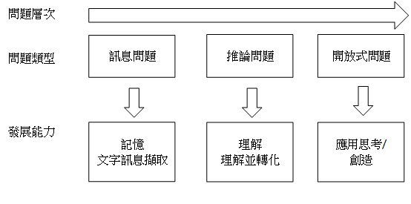
Questions and 6W
Framework
Principles & Activities
Reading Tasks
Reading Assessment
Principles
淺 深
Reading Stages
Strategies
Questions
Notes:
與6W問題形態作連結

Slide 27
Questions Types and 6W
Framework
Principles & Activities
Reading Tasks
Reading Assessment
Principles
Predicting→ Questioning→ Clarifying→ Summarizing
Literal Comprehension Questions
Reorganization/ Reinterpretation
Inferential
Evaluative
Personal response
Questions concerned with how writers say what they mean
Reading Stages
Strategies
Questions
Notes:
與6W問題形態作連結

Slide 28

Discussion 4
Framework
Principles & Activities
Reading Tasks
Reading Assessment
Principles
Hello Kids 6
Lesson one & two
1. What are your questions?
2. Examples
Reading Stages
Strategies
Questions

Slide 29
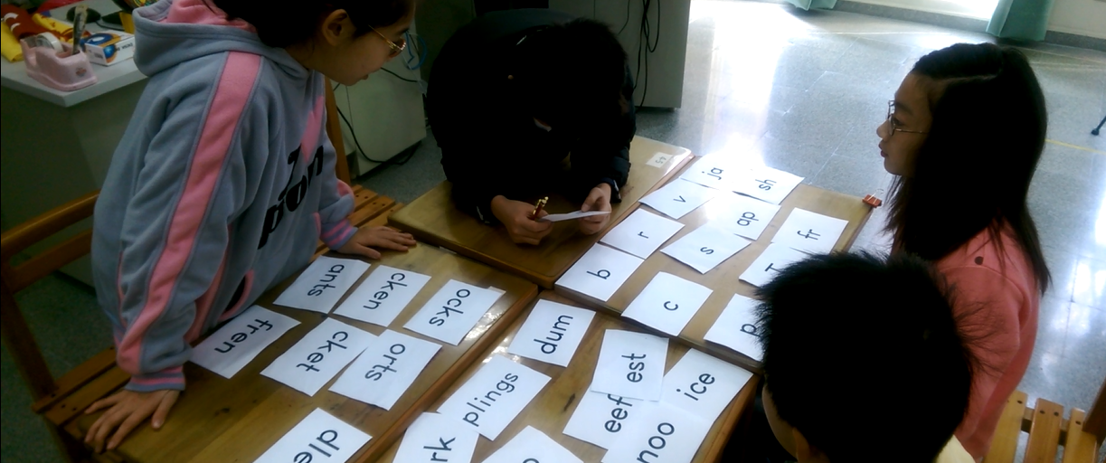
Reading Tasks

Slide 30
Reading Tasks
Framework
Principles & Activities
Reading Tasks
Reading Assessment
Pre-task
Task
Post-task

Slide 31
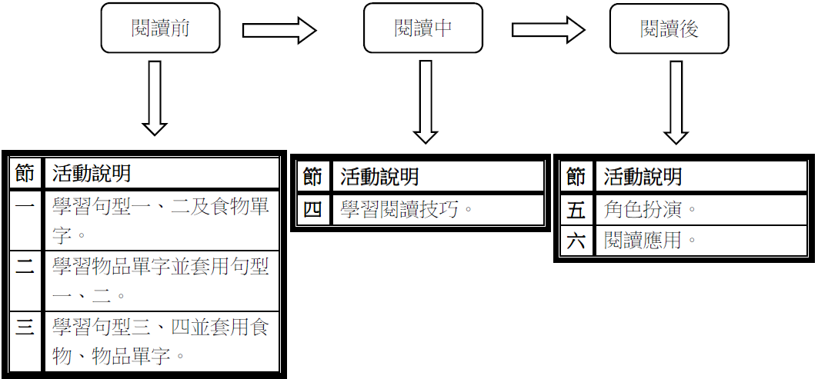
Example
Framework
Principles & Activities
Reading Tasks
Reading Assessment
Notes:
放幾張活動照片說明並讓老師問問題

Slide 32
Discussion 5
Framework
Principles & Activities
Reading Tasks
Reading Assessment
Plan a Reading Lesson
Make Reading Questions
Reference: p50.

Slide 33
Reading Tasks planner
Framework
Principles & Activities
Reading Tasks
Reading Assessment
Pre-tasks
Tasks
Post-tasks
Notes:
Scaffolding = schema

Slide 34
Check your planner
Framework
Principles & Activities
Reading Tasks
Reading Assessment
Use KWL to estimate your students’ ability before and after your instruction.(ZPD)
Do your Pre-tasks contain the materials your students have learned? (scaffolding)
Do you give students enough inputs to learn what you want to teach? (scaffolding)
Do you use interactive reading instruction in the tasks? (Top down/ Bottom up)
Do your pre-tasks, tasks and Post-tasks well connected? (scaffolding)
Are your students able to apply what they have learned from the reading tasks on the Post –tasks? (Learn to read/ Read to learn)
Are students able to finish the post task without assistants? (scaffolding)

Slide 35

Reading Assessment

Slide 36
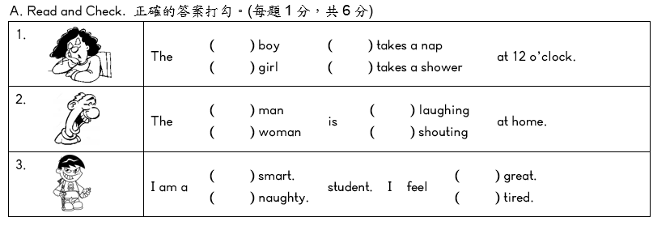
3-1-2 能辨識課堂中習得的詞彙
Framework
Principles & Activities
Reading Tasks
Reading Assessment
Notes:
對應閱讀的能力指標

Slide 37
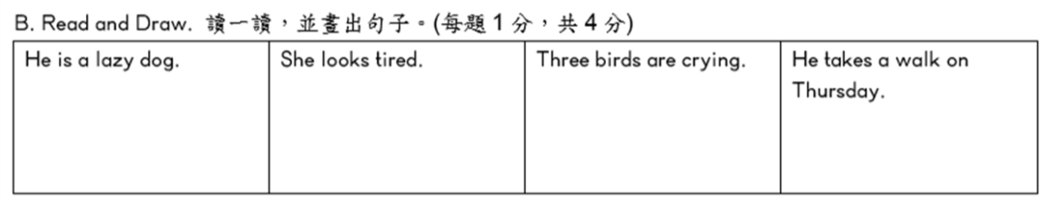
3-1-5 能看懂簡單句子
Framework
Principles & Activities
Reading Tasks
Reading Assessment

Slide 38
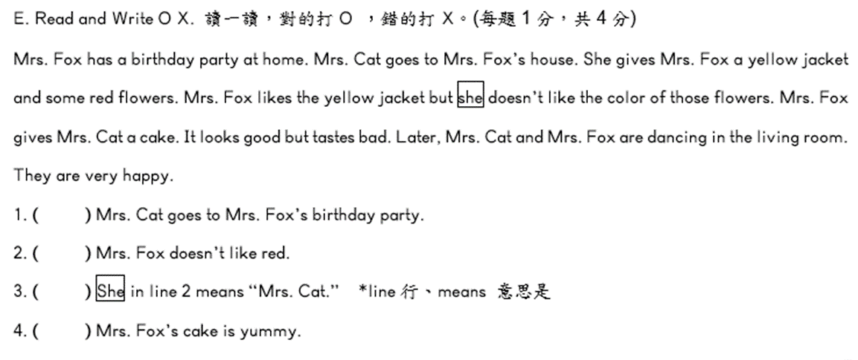
3-1-5 能看懂簡單句子
Framework
Principles & Activities
Reading Tasks
Reading Assessment

Slide 39
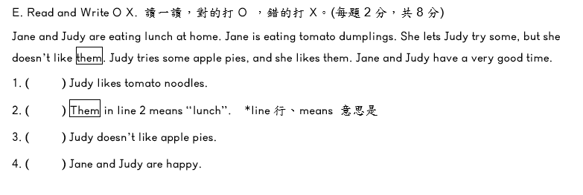
3-1-5 能看懂簡單句子
Framework
Principles & Activities
Reading Tasks
Reading Assessment

Slide 40
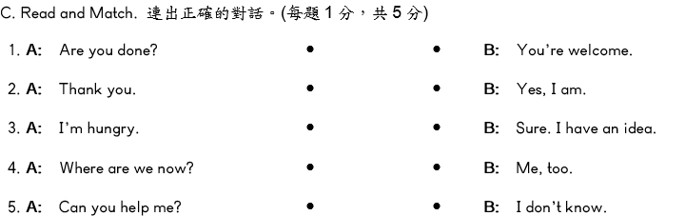
3-1-5 能看懂簡單句子
Framework
Principles & Activities
Reading Tasks
Reading Assessment

Slide 41
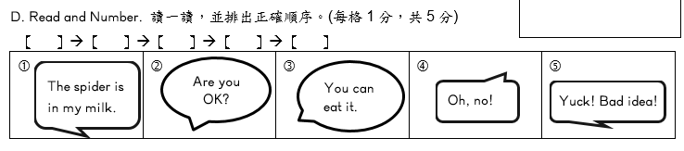
3-1-5 能看懂簡單句子
Framework
Principles & Activities
Reading Tasks
Reading Assessment

Slide 42
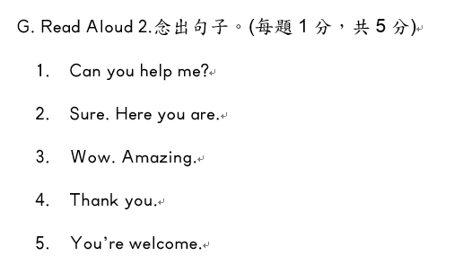
3-1-7 能朗讀課本中的對話和故事
Framework
Principles & Activities
Reading Tasks
Reading Assessment

Slide 43
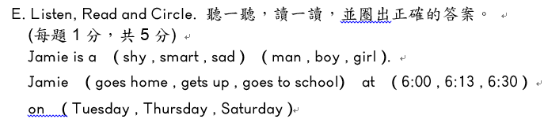
5-1-3 在聽讀時，能辨識書本中相對應的書寫文字
Framework
Principles & Activities
Reading Tasks
Reading Assessment

Slide 44

5-1-6 能運用字母拼讀法
Framework
Principles & Activities
Reading Tasks
Reading Assessment

Slide 45
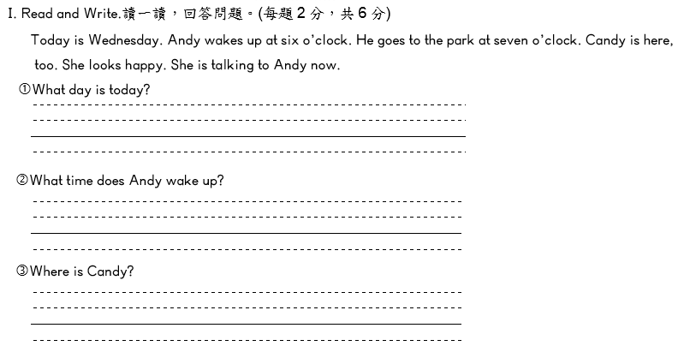
3-1-5 能看懂簡單句子
4-1-7 能掌握英文書寫格式寫出簡單句子
Framework
Principles & Activities
Reading Tasks
Reading Assessment

Slide 46
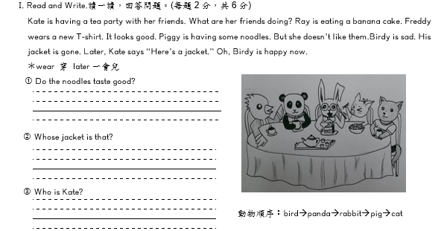
3-1-5 能看懂簡單句子
4-1-7 能掌握英文書寫格式寫出簡單句子
4-1-8 能藉圖片、標題、書名，猜測或推論主題
Framework
Principles & Activities
Reading Tasks
Reading Assessment

Slide 47
Discussion 6
Make exam questions based on the curriculum guidelines.

