Slide 1
Communicative Language Learning Sharing and Discussion
2015年3月27日 黃毓珍 教師研習中心

Slide 2
Communicative Language Learning
An approach to language teaching that emphasizes interaction as both the means and the ultimate goal of study.

Slide 3
Topics
Classroom Language
Task-Based Learning
Differentiation in the Mixed Ability Classroom
Listening and Speaking
Pair and Group Work

Slide 4
Main Idea
Authentic Language
Scaffolding
Classroom Language
Task-Based Learning
Differentiation Teaching
Listening and Speaking
Pair and Group work

Slide 5
WHAT IS CLASSROOM LANGUAGE?

Slide 6
Classroom Language-Who says that?
Teacher’s Teacher’s/learner’s Learners’
Language language language
Classroom Language
Task-Based Learning
Differentiation Teaching
Listening and Speaking
Pair and Group work

Slide 7
Discussion 1

Slide 8
Classroom Language
Procedural Language
Functional Language
Target Language
Classroom Language
Task-Based Learning
Differentiation Teaching
Listening and Speaking
Teacher’s Language
Teacher’s/ Learner's Language
Learner’s Language
Pair and Group work
Notes:
教室使用的語言/兒童初學者先教功能語

Slide 9
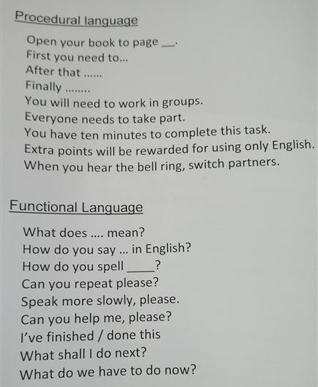
Classroom Language
Task-Based Learning
Differentiation Teaching
Listening and Speaking
Pair and Group work

Slide 10
Discussion 2

Slide 11
Discussion 2
Activity | Procedural Language used by the teacher to set up the activity | Functional Language needed by the students to complete the activity | Target Language
Classroom Language
Task-Based Learning
Differentiation Teaching
Listening and Speaking
Pair and Group work

Slide 12
Word Search-Hello kids 6-Lesson 3
Classroom Language
Task-Based Learning
Differentiation Teaching
Listening and Speaking
Pair and Group work

Slide 13
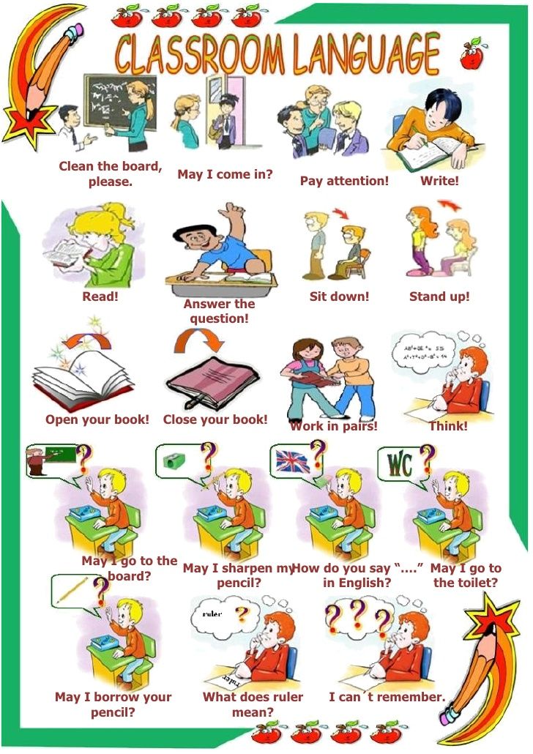
Sample
Classroom Language
Task-Based Learning
Differentiation Teaching
Listening and Speaking
Pair and Group work

Slide 14
Discussion3

Slide 15
The 3 Rs in Classroom Language
Recycle
Reuse
Remember
Classroom Language
Task-Based Learning
Differentiation Teaching
Listening and Speaking
Pair and Group work

Slide 16
Task-Based Learning
Pre-task
Task
Post-task
Classroom Language
Task-Based Learning
Differentiation Teaching
Listening and Speaking
Pair and Group work

Slide 17
Discussion 4

Slide 18
Differentiation in Teaching
What is differentiation in teaching?

Slide 19
Discussion 5

Slide 20
Differentiation in Teaching
差異不一定是能力，也可以是經驗或是學習方式的差異。(多元智能理論)
不同能力學生給與獎勵語不同。
把加分機會先給能力弱的學生。
所有的學生做不同的工作。
彈性分組—全班、兩兩一組、學生自選、老師選、隨機分組
Classroom Language
Task-Based Learning
Differentiation Teaching
Listening and Speaking
Pair and Group work

Slide 21
Discussion 6

Slide 22
原則1掌握學生程度
若學生聽一次就答對表示題目太簡單。聽力練習主要訓練學生專注並了解一連串的語音。
告訴學生「聽什麼」，以免學生抓不到重點、或是認為每個字都要聽懂。這樣會降低學生的學習動機。
不要只接受好學生的答案。應該讓多人回答，並且用再聽一次的方式共同檢核答案。
安排異質分組。程度佳的學生幫助程度低的學生。
Classroom Language
Task-Based Learning
Differentiation Teaching
Listening and Speaking
Pair and Group work

Slide 23
原則2真實及分級的素材
真實情境中有很多雜音。
也有很多贅詞。一開始容易讓學生分心。
若將聽力分類學生就無法熟悉正常的語音。有些學生沒有足夠的聽力，所以老師要設計教學活動讓學生逐步的達到目標。讓學生知道聽的目的不是要聽懂每個字，如此學生會逐漸增加信心並且願意聆聽更多的真實素材。
Classroom Language
Task-Based Learning
Differentiation Teaching
Listening and Speaking
Pair and Group work

Slide 24
原則3異質教學
任務分級，而非素材分級。
先由小範圍的聽力活動開始，一次聽一部分。若有必要可以簡短聽力素材。
可以讓學生多聽幾次。
讓學生知道聽多少。
鼓勵互相訂正。
聽力前活動要讓學生學習足夠的單字和與內容有關概念。
如果學生無法由關鍵字推論內容表示素材過難。
Classroom Language
Task-Based Learning
Differentiation Teaching
Listening and Speaking
Pair and Group work

Slide 25
Listening Activities
Pre-task 1: Vocabulary
Pre-task 2:Listening for gist.
Main task: Listening for more times to have more details.
Post-task: pronunciation such as rhythm.
Classroom Language
Task-Based Learning
Differentiation Teaching
Listening and Speaking
Pair and Group work
Students need to concentrate in listening activities.

Slide 26
Discussion 7
Sara Bareilles - Love Song

Slide 27
Emotional Speaking
Using stories to promote speaking
Classroom Language
Task-Based Learning
Differentiation Teaching
Listening and Speaking
Pair and Group work

Slide 28
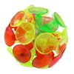
Speaking Review Game
Classroom Language
Task-Based Learning
Differentiation Teaching
Listening and Speaking
Pair and Group work

Slide 29
Ranking activities-list these food in order from the most tasty to least tasty
Now compare your answers with your partner to see if you have the same tastes.
Notes:
A ranking activity is a good main task in a task bases lesson because students need to discuss and compromise.

Slide 30
Pair and Group Work
Good Ideas? Bad Ideas?
What are important factors to take into consideration when setting up pair work and group work?

Slide 31
Teaching Idea Sharing
Teacher you are wrong.
This is not a hammer.
Two words make a sentence.
Earn your recess.
Classroom Language
Task-Based Learning
Differentiation Teaching
Listening and Speaking
Pair and Group work

Slide 32
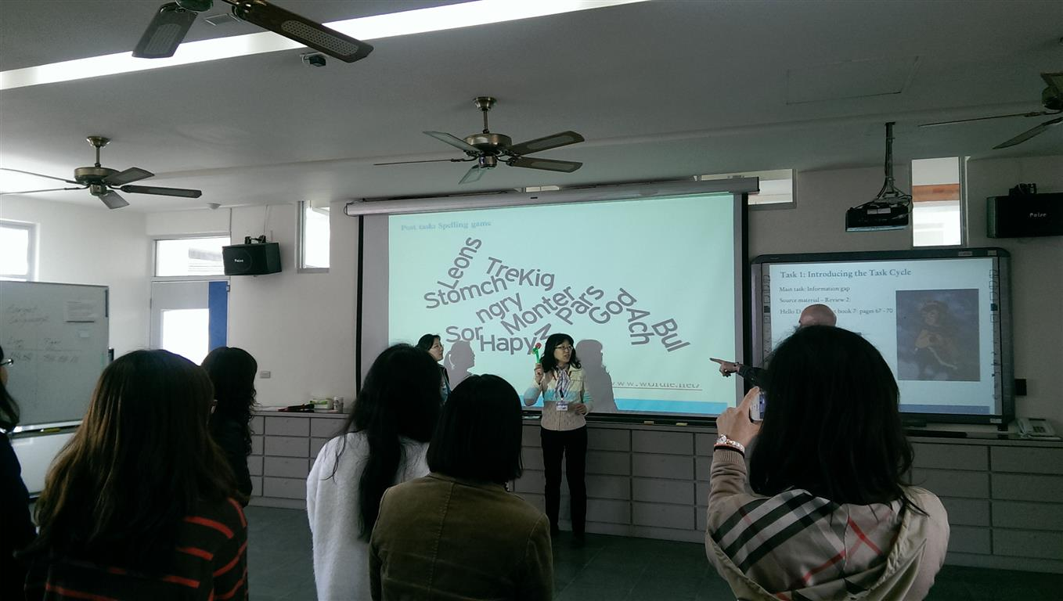
Teaching Idea Sharing

Slide 33
Teaching Idea Sharing

Slide 34
Teaching Idea Sharing

Slide 35
Teaching Idea Sharing

Slide 36
Teaching Idea Sharing

Slide 37
Teaching Idea Sharing

Slide 38
Teaching Idea Sharing

Slide 39
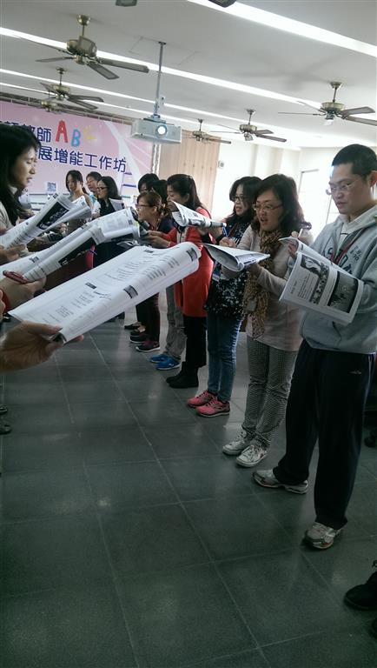
Teaching Idea Sharing

Slide 40
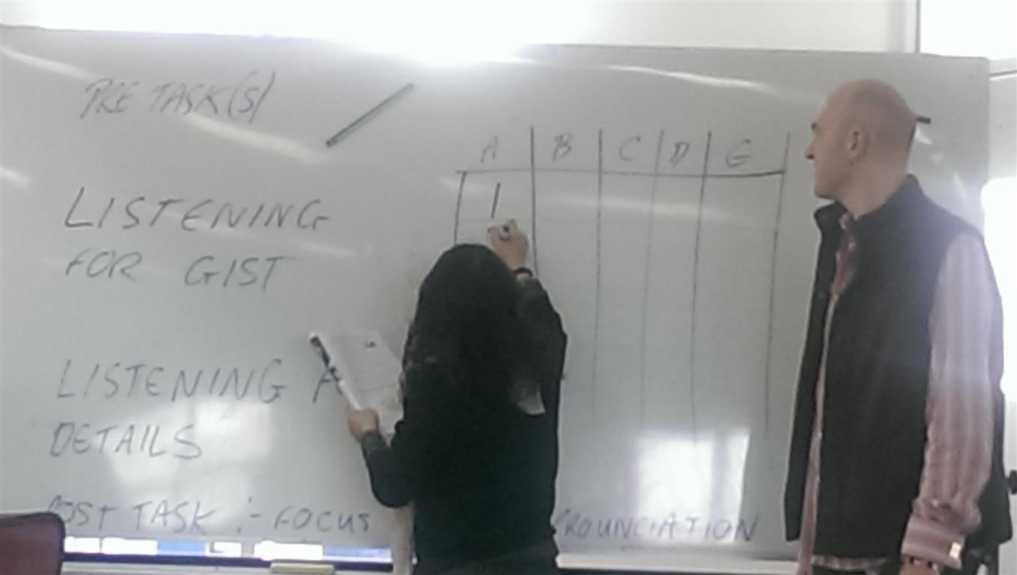
Teaching Idea Sharing

