Slide 1
從屬子句 Although/Though + S + V,…
附件六
(請根據你所看到的圖片及提示，造出含有although從屬子句的句子。)

Slide 2
tired / keep studying

Slide 3
rain / go hiking

Slide 4
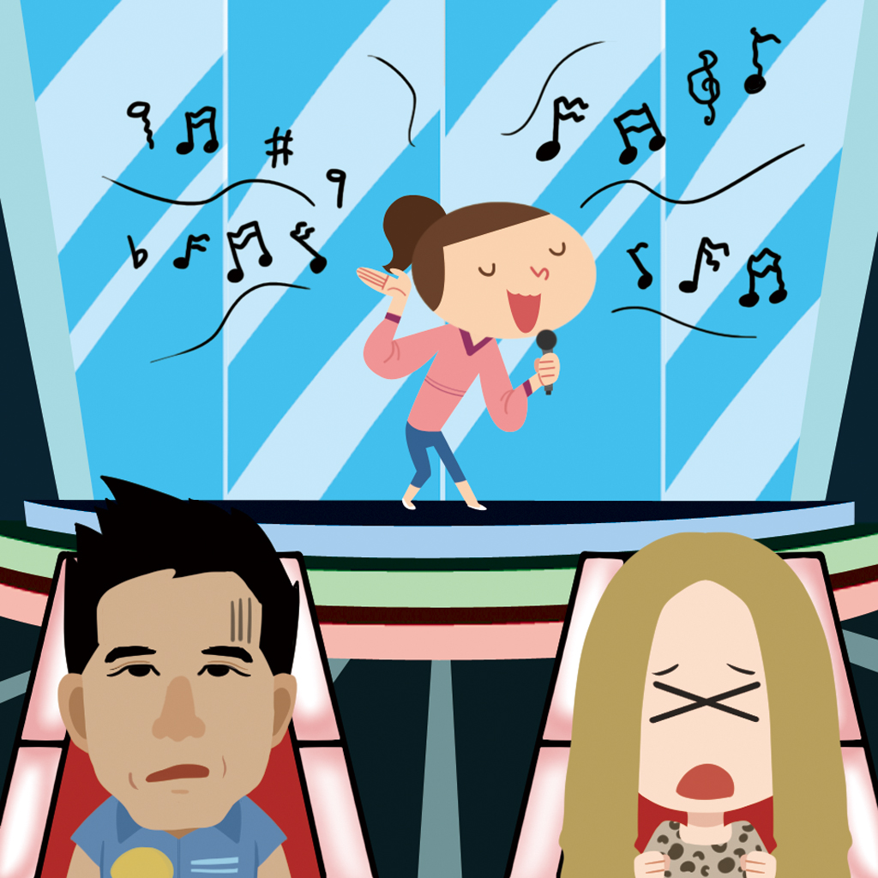
enjoy singing / will not become a singer

Slide 5
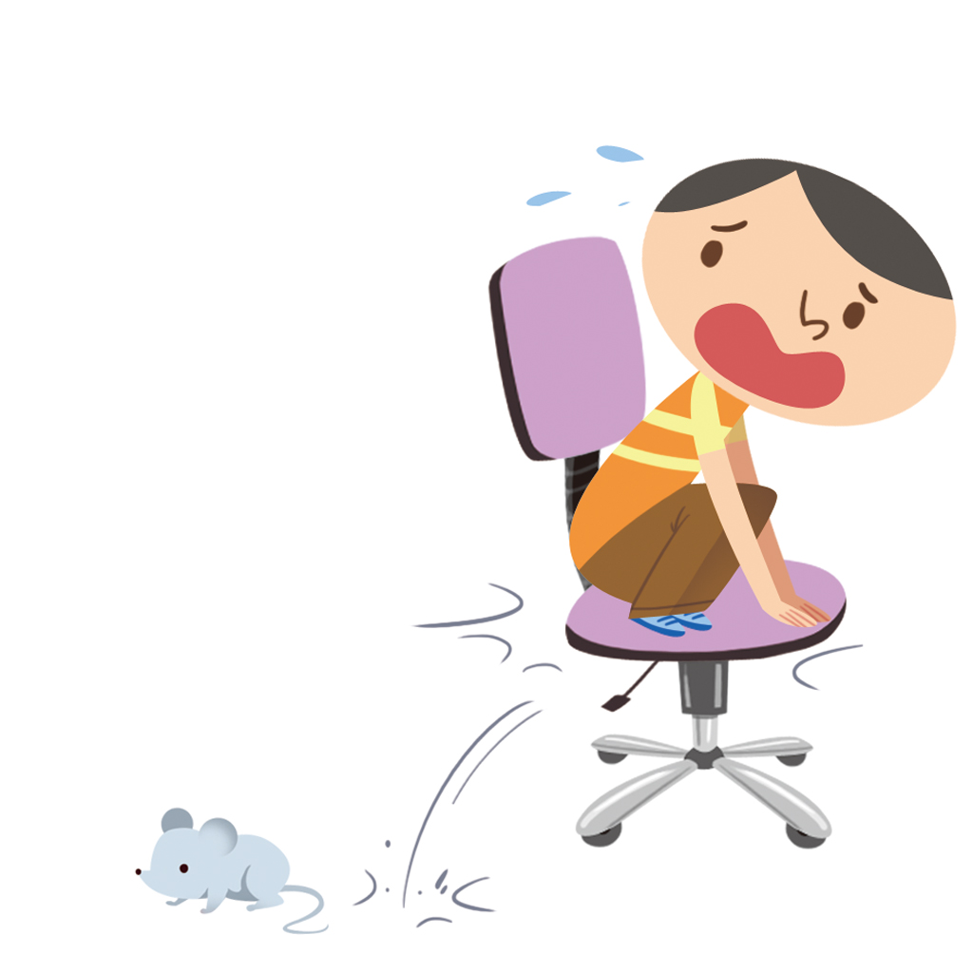
love animals / be afraid of mice

