Slide 1
條件句 If + S + V, S will…
附件五
(請根據你所看到的圖片以及提示造出含有if條件句的句子。)

Slide 2
not study / fail the test

Slide 3
not wash hair / smell bad

Slide 4
typhoon comes / not go outside

Slide 5
the cat moves / the bell

Slide 6
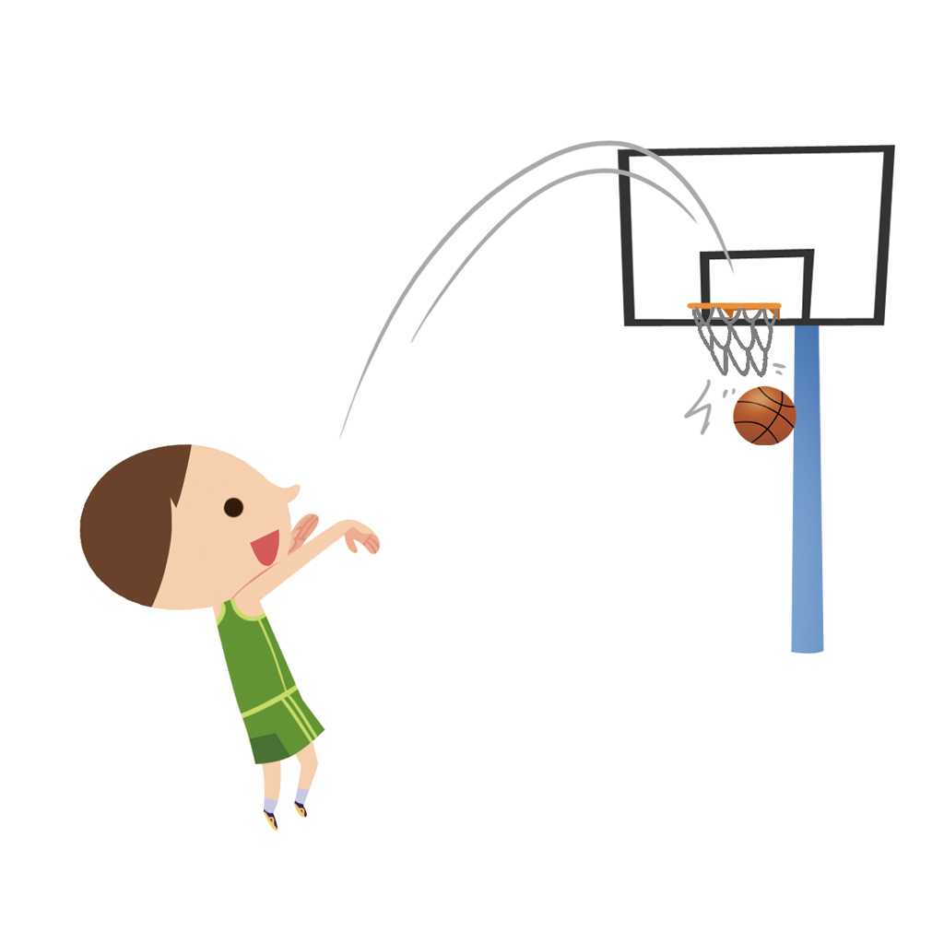
practice / become a good player

