Slide 1


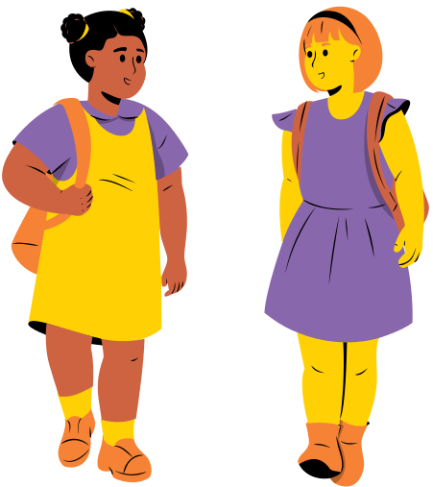
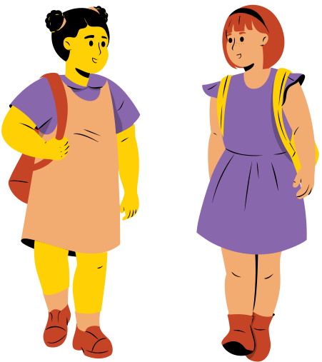

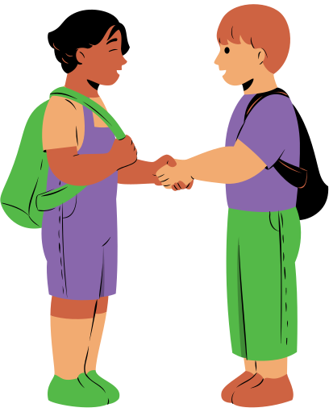


EMPATHY IN ACTION
Respect, Empathy, and Care

Slide 2

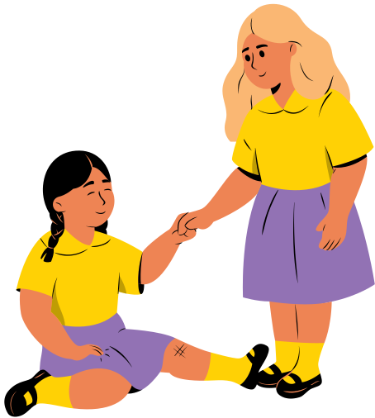
Warm-Up: Spot the Superpower
Q: Have you ever felt sad because your friend was sad?
當看到身邊的朋友陷入困境時，先問問自己這兩個魔法問題：
Q:How would I feel if that happened to me?
Q:What would make me feel better?

Slide 3
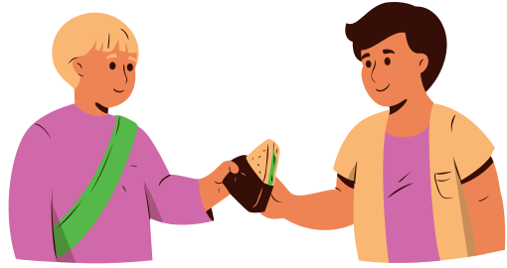

Understanding Empathy
Empathy is the ability to put ourselves in someone else’s shoes. It allows us to feel their struggles and joys. With empathy, we can create deeper and more meaningful connections.
Understanding
Compassion
Connection

Slide 4
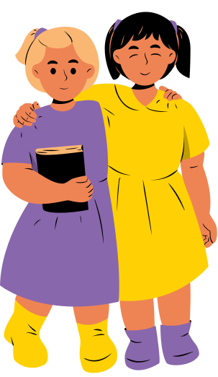

Inclusion
Key Phrase: Do you want to play with me?
Helping
Supporting
Connection

Slide 5
Patience
Key Phrase: Let’s take our time.
Helping
Supporting

Slide 6
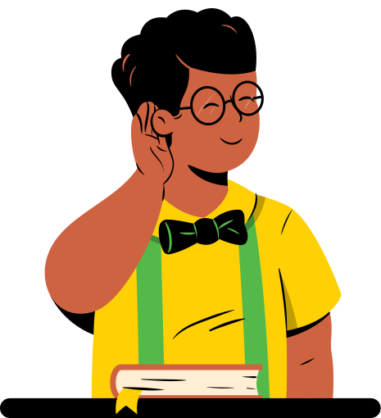
Acceptance
Key Phrase: "We can make mistakes together."
Listening
Valuing others
Fair treatment

Slide 7

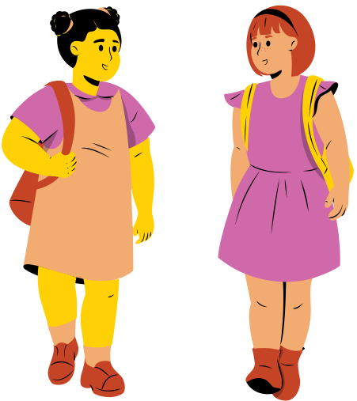
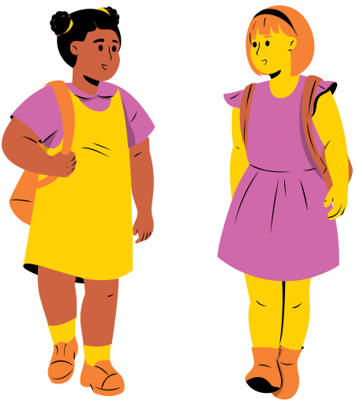

Group Role-Play Activity​
Empathy Role Play (12 mins.)
  Form teams: 3~4人一組，抽取同理心情境卡(如：轉學生獨自用餐、考試落敗、體育課跌倒）
  Two Magic Questions: 討論 "How would I feel?" 與 "What would make me feel better?"​
  3. Practice & Show: 運用至少一句課堂關懷句型演練短劇，並邀請小組上台展現同理行動。

Slide 8


Scenario Matching Practice
Story Situation (情境) | Empathetic Response (同理回應) | Core Value (核心價值)
1. Alia is a new student and sits alone during recess. | "Do you want to play hopscotch with me?"
2. Zahra is afraid of reading out loud because of mistakes. | "We can practice and make mistakes together!"
3. Darren hurt his foot and is struggling to keep up. | "Don't worry. Let's take our time and walk together."
Acceptance

Slide 9
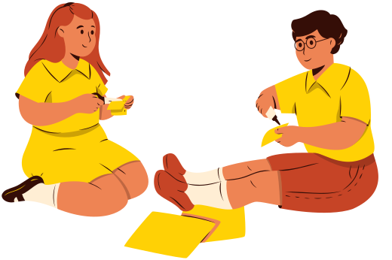
Pass the Superpower!
Empathy is contagious — start spreading kindness today!
請在便條紙寫下對同伴的關懷，並張貼至教室後方的 "Empathy Tree" 海報！

Slide 10
Living as a Good Human
“Being a good human is a lifelong journey. It’s about making choices that spread kindness and love. Together, we can create a better, more compassionate world.”

