Slide 1
全英語課程設計理論與實務 III
Ivy Haoyin Hsieh
謝 顥 音
淡江大學蘭陽校園
英美語言文化學系

Slide 2
What did we discuss before? -1
Goal of English Education
Myth of Bilingual Education
CLIL
Professional Teaching
Learning Performance
Classroom English
Practice with Picture books

Slide 3
What did we discuss before? -2
ESL vs EFL
How do you “teach”?
Methods
Activities
Strategies
Practices

Slide 4
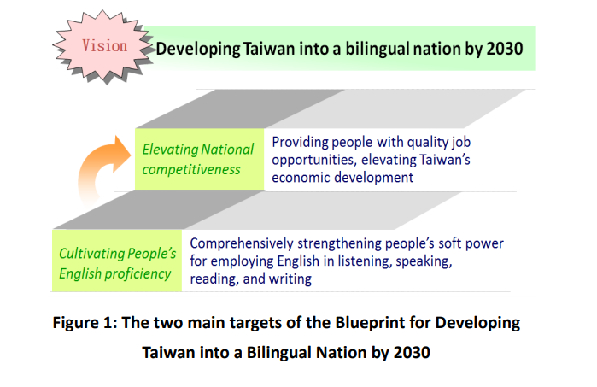
Promoting Bilingual Education
National Development Council. Blueprint for Developing Taiwan into a Bilingual Nation by 2030. Issued by the Executive Yuan on Dec. 2018.

Slide 5
Part I: 1330-1420 Theories (理想) & Teams in Taiwan (現況)

Slide 6
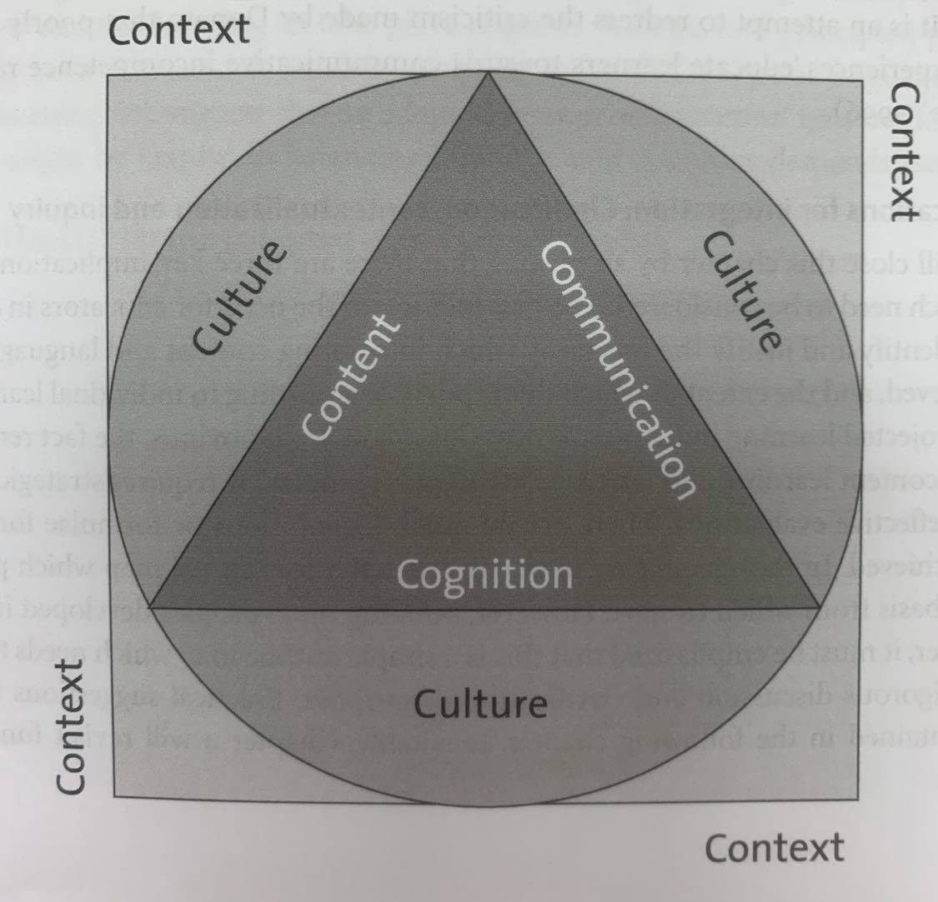
CLIL: The 4Cs Framework
Coyle, D. Hood, P. and March, D. (2010). CLIL: Content and language integrated learning. Cambridge, UK: Cambridge University Press. (p.36)

Slide 7
Content Language Integrated Learning
Context/Culture
Social constructivist learning: social interaction between learners and teachers and scaffolded learning
Cognitive engagement: Effective content learning through creative thinking, problem solving and cognitive challenge
Content/Communication
Language for learning: bridging prior content knowledge
Language of learning: bridging prior language knowledge
Language through learning: Integrating content and language
(Coyle, Hood, and March, 2010)
Translanguaging Approach
interaction and relationship between language and identities in contexts where communication is mobile and complex
(Canagarajah, 2011; Creese & Blackledge, 2010; Lin, 2020)
Elementary –middle school Level (?)

Slide 8
Content-based Instruction
Use English to learn
Integrates the learning of language with the learning of some other content. Content can be themes, topic or academic subjects.
Language (English) for academic purpose (EAP)
Language (English) for specific purpose (ESP)
Similar to Whole Language Approach
Educator provide content-rich curriculum where language and thinking can be about interesting and significant content
Vygotsky’s ZPD: higher order thinking through social interactions
(Edelsky, Altwerger, and Flores, 1991, from Larsen and Freeman and Anderson, 2011)

Slide 9
English-Medium Instruction
MOE EMI Enhancement Plan 2021-2026
the program on Bilingual Education for Students in College (BEST)
Definition of EMI course
The delivery of content, the interaction between students and teachers, the learning material, and the demonstration and assessment of learning outcomes (such as oral presentation, assignments, or tests) should be 100% in English.
Other languages may be used by students in a limited way in specific circumstances.
Student-to-student interaction in pair work and group work may sometimes take place in languages other than English to aid mutual comprehension and idea generation. However, students should present their discussion outcomes in English.
Encourage students to engage in English speaking and writing as much as possible.

Slide 10
陳錦芬教授 http://immersion.ntue.edu.tw
沉浸式英語教學
計畫目標
建構真實的英語溝通學習情境，讓英語不只是一門學科，也是體驗和習得不同學科領域知識和技能的學習工具。
在教室情境中營造多語言、多元文化的氛圍，鼓勵學生應用英語來表達、分享和互動，以提升學生英語聽、說的溝通能力。
引導國民中小學教師發展適合學生心智發展與興趣之英語融入各領域的課程設計與教學活動。
提供未來國民中小學英語融入各領域教學相關課程設計及教學活動之參考。

Slide 11
本土雙語教育模式 計畫目標
林子斌教授 https://clseap.ccu.edu.tw/
雙語教育不是英語教學，但是兩者互為表裡、相輔相成。
雙語教育並非全英語教學：應提供現場教師彈性推動雙語教育。
切勿盲目移植國外經驗或未經轉化之特定教學取向：應回歸語 言溝通的本質。雙語教育在臺灣的推動不應盲目，反而應思考如何透過雙語教育之推動， 讓學生理解到英語不是學科，而是可於日常使用之溝通的語言。
以學科教學為主之雙語教育：應以學科知識的習得為重、語言環境與語言使用為輔。
雙語環境之建置：以學校為單位考量，著重於學校整體雙語環境的建構。因此，除雙語授課的教師外，校長、行政等都應該成為雙語使用者，讓學生在學校中體驗到雙語溝通的環境。

Slide 12
程玉秀教授 http://www.emi.eng.ntnu.edu.tw/
雙語教學研究中心
研發中學階段以中英雙語授課之課程架構
研發中學階段以中英雙語授課之參考教材
研發中學階段以中英雙語授課之教學方法和策略
探究中學階段以中英雙語授課課程之學習評量議題與機制
發展中英雙語授課師資培育課程（含見習與實習相關規範與評量機制）
辦理中英雙語授課相關工作坊或研習，並推廣中英雙語授課資訊

Slide 13
Before we start today’s sharing… Bilingual? English Only?
Note
It is important for students to establish literacy in their native language before learning to read and write another language
It is important to draw on what is known about how students learn in order to develop a program that meets their needs
Larsen-Freeman, D. and Anderson, M. (2011). Techniques & principles in language teaching. (3rd Ed.). New York: Oxford University Press.

Slide 14
English-only Teaching Model Observation Key
Preparation
Regular Curriculum
Methods used
Strategies

Slide 15
Part II: Teaching Demo and sharing
1430-1500 Vivian’s English-taught English classes
1500-1530 Tony’s (more of) Content-based Instruction

Slide 16
Part III 1530-1620 Feedback and Discussions

Slide 17
Preparation and Curriculum
Vivian’s class
Tony’s class
Classroom English
Vocabulary
Grammar
Textbook Unit 2
homework
Focus is on English but not content
Oral Practice
Related vocabulary
Prior knowledge
Textbook Unit 4 (8th grade)
Supplementary materials
Focus more on English than content

Slide 18
Methods and Strategies
Vivian’s class
Tony’s class
Communicative Language Teaching
Games
Audio-lingual Method
Drills
Daily Routine
Greetings
Building rapport
Small talk
Personal information
Critical thinking and problem solving
Outcome opportunities
Diverse Background knowledge Input
Scripts reading
Professional commands practice
Audio-visual support
(out-of-class) immersion: video for casual
Critical thinking and problem solving
Show time

Slide 19
Discussions
Teaching style
Teaching philosophy
Motivation
Curriculum and Testing
Time consuming

