Slide 1


2020.10.30.
12-Year Basic Education
New Curriculum
KSJH
Susan Chen

Slide 2






Why the new curriculum?
What is the new curriculum?
What is different?
Features in the English curriculum
Content in the English curriculum
Competency-Based Curriculum Design

Slide 3


壹 Why the new
curriculum?
ENGLISH

Slide 4
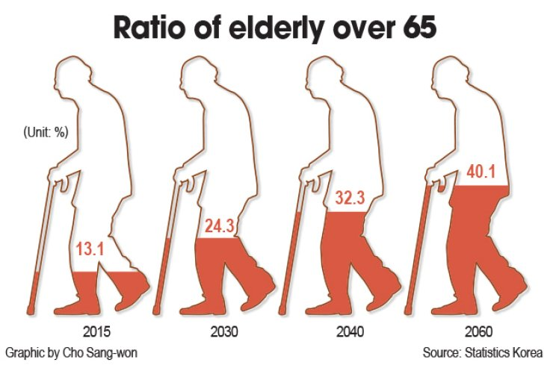

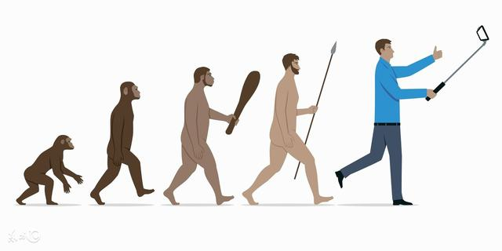

Why do we need the new curriculum?

Slide 5
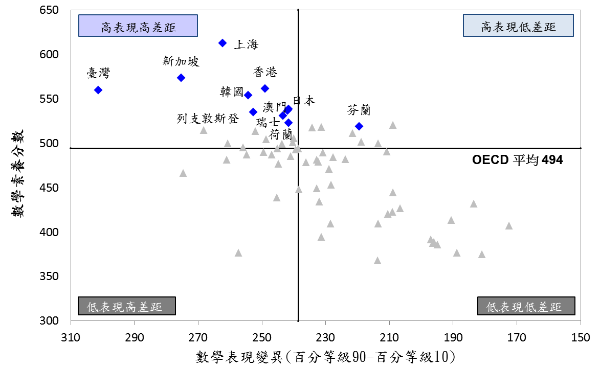
Why do we need the new curriculum?
Growing Achievement Gap
高表現高差距
PISA 2012各國數學素養表現變異，臺灣前後段學生差距世界第一

Slide 6
Why do we need the new curriculum?
Low birth rate
Develop talent in every student
資料來源：內政部戶政司年度新生兒總人數

Slide 7
貳 What is it?
ENGLISH

Slide 8


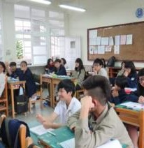
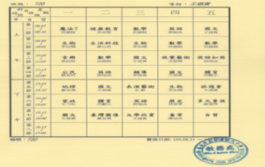

Developing talent in every student
The Vision
Nurture by nature, and promoting life-long learning
圖片來源：維基百科、
介壽國中 、華南國小
8

Slide 9

Fundamental beliefs
Taking initiative
Engaging in communication
Seeking the common good

Slide 10
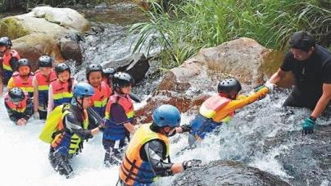
Curriculum Goals
Inspire Students to Unleash their Full Potential
Teach and Develop Students‘ Knowledge about Life
Promote Students’ Career Development
Instill Civic Responsibility in Students
圖片來源：宜蘭縣內城中小學

Slide 11
Core Competencies核心素養
Derived from a framework developed by the Organization for Economic Cooperation and Development (2005)
Used as the basis of curriculum development
To ensure continuity between educational stages, make connections between domains, and achieve integration of subjects.

Slide 12
Core Competencies
All information, ability, and attitude that a person should possess to equip him or her for daily life and for tackling future challenges.
The concept of core competency emphasizes that learning should consider real-life scenarios and emphasize holistic development through action and self-development.

Slide 13
Three dimensions
Lifelong learner
Spontaneity
Communication
and interaction
Social
participation
Three major dimensions were identified, which were further divided into nine items.

Slide 14
Lifelong learner
spontaneity
physical and mental wellness and self-advancement
social participation
moral praxis and citizenship
communication and interaction
semiotics and expression
logical thinking and problem solving
planning, execution, innovation and adaptation
artistic appreciation and aesthetic literacy
information and technology literacy and media literacy
interpersonal relationships and teamwork
cultural and global understanding

Slide 15

3 Dimension and 9 Items of Core Competencies
Real-Life Scenarios
A2
A3
Logical Thinking and Problem Solving
Planning, Execution, Innovation, and Adaptation
A1
B1
Physical and Mental Wellness, and Self-Advancement
Semiotics and Expression
Spontaneity
C3
Life-Long
Learner
B2
Communication
and Interaction
Information and Technology Literacy and Media Literacy
Cultural and Global Understanding
Social
Participation
B3
Real-Life Scenarios
C2
Interpersonal Relationships and Teamwork
Artistic Appreciation and Aesthetic Literacy
Real-Life Scenarios
C1
Moral Praxis and Citizenship

Slide 16
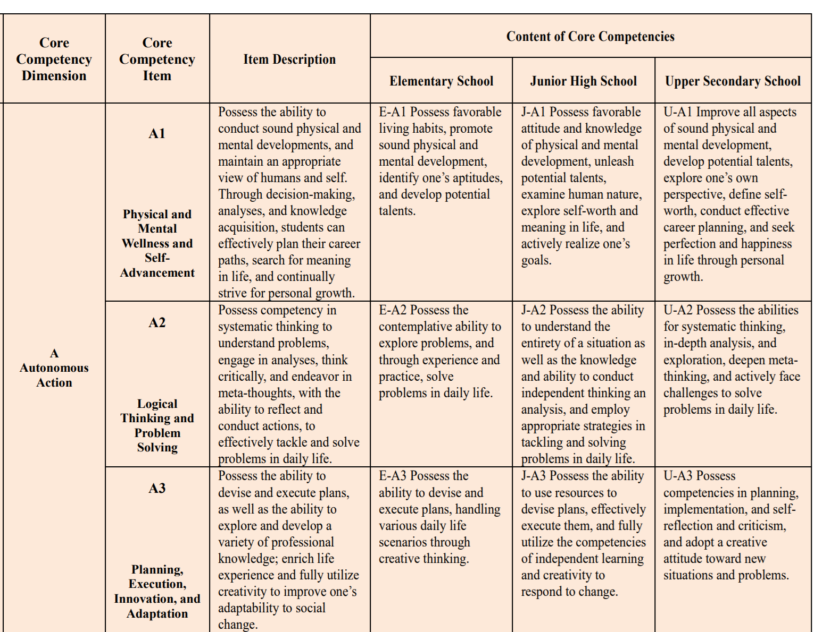
Content in Each Educational Stage

Slide 17
參 What is
different now?
ENGLISH

Slide 18
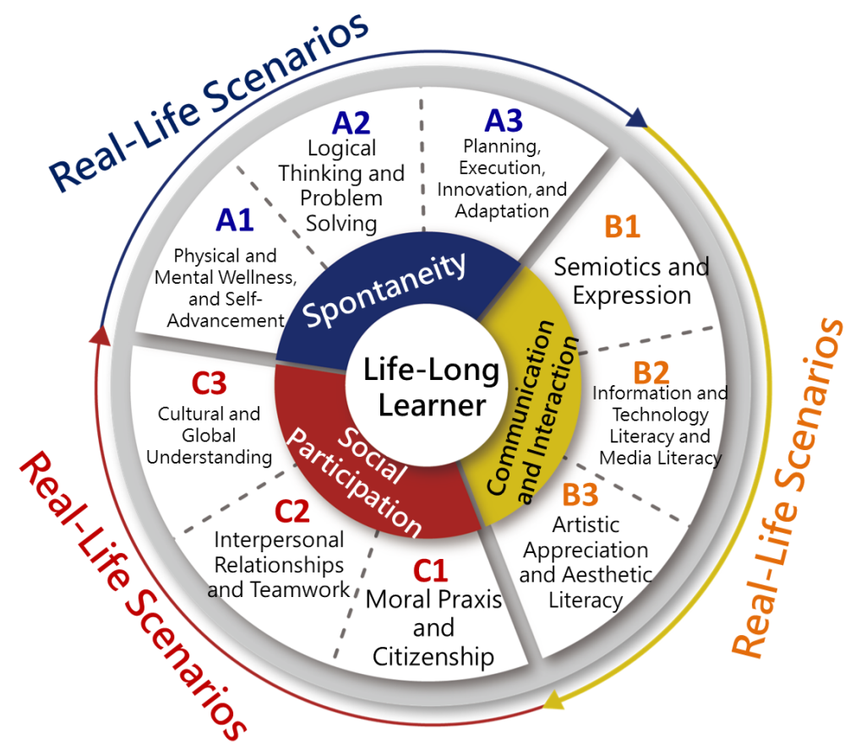
What is different?
Before vs Now
Self-understanding and exploration of potentials.
Appreciation, representation, and creativity.
Career planning and lifelong learning.
Expression, communication, and sharing.
Respect, care and team work.
Cultural learning and international understanding.
Planning, organizing and putting plans into practice.
Utilization of technology and information.
Active exploration and study.
Independent thinking and problem solving.

Slide 19
Changes
Knowledge-based
Ability-based
Competency-based
9-year compulsory education to 12-year basic education
No tuition fee for high school
Open classroom observation, collaborative lesson preparation
New Domain- Technology

